Slide 1
Mining the World-Wide Web
The WWW is huge, widely distributed, global information service center for
  Information services: news, advertisements, consumer information, financial management, education, government, e-commerce, etc.
  Hyper-link information
  Access and usage information
WWW provides rich sources for data mining
Challenges
  Too huge for effective data warehousing and data mining
  Too complex and heterogeneous: no standards and structure

Slide 2
Web Mining: A more challenging task
Searches for
  Web access patterns
  Web structures
  Regularity and dynamics of Web contents
Problems
  The “abundance” problem
  Limited coverage of the Web: hidden Web sources, majority of data in DBMS
  Limited query interface based on keyword-oriented search
  Limited customization to individual users

Slide 3
Web Mining Taxonomy
Web Mining
Web Content
Mining
Web Structure
Mining
Web Usage
Mining
Web Page
Content Mining
Search Result
Mining
General Access
Pattern Tracking
Customized
Usage Tracking

Slide 4
Mining the World-Wide Web
Web Mining
Web Content
Mining
Web Structure
Mining
Web Usage
Mining
Web Page Content Mining
Web Page Summarization
WebLog ,
WebOQL …:
Web Structuring query languages;
Can identify information within given web pages
Ahoy! :Uses heuristics to distinguish personal home pages from other web pages
ShopBot : Looks for product prices within web pages
Search Result
Mining
General Access
Pattern Tracking
Customized
Usage Tracking

Slide 5
Mining the World-Wide Web
Web Mining
Web Content
Mining
Web Structure
Mining
Web Usage
Mining
Web Page
Content Mining
Search Result Mining
Search Engine Result Summarization
Clustering Search Result :
Categorizes documents using phrases in titles and snippets
General Access
Pattern Tracking
Customized
Usage Tracking

Slide 6
Mining the World-Wide Web
Web Mining
Web Content
Mining
Web Usage
Mining
Web Structure Mining
Using Links
PageRank
CLEVER
Use interconnections between web pages to give weight to pages.
Using Generalization
MLDB, VWV
Uses a multi-level database representation of the Web. Counters (popularity) and link lists are used for capturing structure.
Search Result
Mining
General Access
Pattern Tracking
Web Page
Content Mining
Customized
Usage Tracking

Slide 7
Mining the World-Wide Web
Web Mining
Web Content
Mining
Web Structure
Mining
Web Usage
Mining
Web Page
Content Mining
General Access Pattern Tracking
Web Log Mining
Uses KDD techniques to understand general access patterns and trends.
Can shed light on better structure and grouping of resource providers.
Customized
Usage Tracking
Search Result
Mining

Slide 8
Mining the World-Wide Web
Web Mining
Web Content
Mining
Web Structure
Mining
Web Usage
Mining
Web Page
Content Mining
General Access
Pattern Tracking
Customized Usage Tracking
Adaptive Sites
Analyzes access patterns of each user at a time.
Web site restructures itself automatically by learning from user access patterns.
Search Result
Mining

Slide 9
Web Usage Mining
Mining Web log records to discover user access patterns of Web pages
Applications
  Target potential customers for electronic commerce
  Enhance the quality and delivery of Internet information services to the end user
  Improve Web server system performance
  Identify potential prime advertisement locations
Web logs provide rich information about Web dynamics
  Typical Web log entry includes the URL requested, the IP address from which the request originated, and a timestamp

Slide 10
Techniques for Web usage mining
Construct multidimensional view on the Weblog database
  Perform multidimensional OLAP analysis to find the top N users, top N accessed Web pages, most frequently accessed time periods, etc.
Perform data mining on Weblog records
  Find association patterns, sequential patterns, and trends of Web accessing
  May need additional information,e.g., user browsing sequences of the Web pages in the Web server buffer
Conduct studies to
  Analyze system performance, improve system design by Web caching, Web page prefetching, and Web page swapping

Slide 11




Mining the World-Wide Web
Design of a Web Log Miner
  Web log is filtered to generate a relational database
  A data cube is generated form database
  OLAP is used to drill-down and roll-up in the cube
  OLAM is used for mining interesting knowledge
Knowledge
Web log
Database
Data Cube
Sliced and diced
cube
1
Data Cleaning
2
Data Cube
Creation
3
OLAP
4
Data Mining

Slide 12
Association Rules
Association rules can be used to find what web pages are accessed together by the same user in a session.
The support level of association rule of web pages X1, X2….Xn is
Frequent occurrences of X1, X2…..Xn
Total number of Web pages occurrences

Slide 13
Example of association rules
The XYZ Corporation maintains a set of five web pages: {A, B, C, D, E}. The following sessions have been created:
S1 = {U1, <A, B, C>}
S2 = {U2, <A, C>}
S3 = {U1, <B, C, E>}
S4 = {U3, <A, C, D, C, E>}
Where u1, u2 and u3 are the identifies of three users and the support threshold is 30%, which is 4 * 0.3 = 1.2 ≈ 2 sessions

Slide 14
Since there are 4 transactions and the support is 30%, an itemset must occur in at least 2 sessions. Let L be the large frequent data set and C be the candidate frequent data set, we find the following by applying Apriori algorithm:
L1 = {(A), (B), (C), (E)}
C2 = {(A, B), (A, C), (A, E), (B, C), (B, E), (C,E)}
L2 = {(A, C), (B, C), (C, E)}
C3 = {(A, B, C), (A, C, E), (B, C, E)}
As a result, the following web page(s) occurred together at least twice in the 4 transactions:
L = {(A), (B), (C), (E), (A, C), (B, C), (C, E)}

Slide 15
Sequential Patterns
A sequential pattern is defined as an ordered set of pages that satisfies a given support and is maximal (i.e. it has no subsequence that is also frequent).
In other words, sequential pattern is the ordered set of web pages browsed by a user in a session.
The support level of sequential patterns is
Frequent forward ordering web pages occurrences of X1, X2…Xn
Each Customer/User

Slide 16
AprioriAll algorithm for sequential pattern
AprioriAll algorithm:
Ck: Candidate itemset of size k
Lk : frequent itemset of size k
L1 = {frequent items};
for (k = 1; Lk !=∅; k++) do begin
Ck+1 = candidates generated from Lk with different mutation (i.e. sequence order)
for each transaction t in database do
increment the count of all candidates in Ck+1 that are contained in t
Lk+1 = candidates in Ck+1 with min_support
end
return ∪k Lk;

Slide 17
Algorithm of sequential patterns of web pages
Input:
D = {S1, S2…Sk} where D is the database of session(s) S
S = Support level
Output:
Sequential Patterns
Begin
D = sort D on user-ID and time of first page reference in
each session;
Find L1 in D;
L = AprioriAll (D, S, L1);
Find maximal reference sequences from L;
end

Slide 18
In the previous example, user U1 has two sessions. U1’s sequential patterns is the concatenation of pages in S1 and S3.
A sequence is large if it is contained in at least one customer’s sequence.
After the sort step, we have D as
{S1={U1, (A, B, C)}, S3={U1, (B, C, E)}, S2={U2, (A, C)>, S4={U3, (A, C, D, C, E)}
L1 = {(A), (B), (C), (D), (E)} since each page is referenced by at least one customer.

Slide 19
Outlines of steps by AprioriAll
C1={(A), (B), (C), (D), (E)}
L1={(A), (B), (C), (D), (E)}
C2={(A,B), (A,C), (A,D), (A,E), (B,A), (B,C), (B,D), (B,E), (C,A), (C,B), (C,D), (C,E), (D,A), (D,B), (D,C), (D,E), (E,A), (E,B), (E,C), (E,D)}
L2 ={(A,B), (A,C), (A,D), (A,E), (B,C), (B,E), (C,B), (C,D), (C,E), (D,C), (D,E)}
C3={(A,B,C), (A,B,D), (A,B,E), (A,C,B), (A,C,D), (A,C,E), (A,D,B), (A,D,C), (A,D,E), (A,E,B), (A,E,C), (A,E,D), (B,C,E), (B,E,C), (C,B,D), (C,B,E), (C,D,B), (C,D,E), (C,E,B), (C,E,D), (D,C,B), (D,C,E), (D,E,C)}
L3= ={(A,B,C), (A,B,E), (A,C,B), (A,C,D), (A,C,E), (A,D,C), (A,D,E), (B,C,E), (C,B,E), (C,D,E), (D,C,E)}
C4={(A,B,C,E), (A,B,E,C), (A,C,B,D), (A,C,B,E), (A,C,D,B), (A,C,D,E), (A,C,E,B), (A,C,E,D), (A,D,C,E), (A,D,E,C)
L4={(A,B,C,E), (A,C,B,E), (A,C,D,E), (A,D,C,E))
C5=0
Thus, the answer of the sequential patterns is L4.

Slide 20
Maximal Frequent Forward Sequences
Forward sequences is to remove any backward traversals. Each raw session is transformed into forward reference (i.e. remove the backward traversals and reloads/refreshes), from which the traversal patterns are then mined using improved level-wise algorithms.
The forward sequence occurrences of web pages X1, X2….Xn is
Frequent forward occurrences of web pages X1, X2…Xn
Total number of Forward Seqeunces

Slide 21
Algorithm of maximal frequent forward sequential patterns of web pages
Input:
D = {S1, S2…Sk} where D is the database of session(s) S
S = Support level
Output:
Maximal reference sequences
Begin
Find maximal forward references from D;
Find large reference sequences from the maximal ones;
Find maximal reference sequences from the large ones;
end

Slide 22
Example of forward sequences
Given D={A,B,C,D,E,D,C,F), (A,A,B,C,D,E), (B,G,H,U,V), (G,H,W)}. The first session has backward traversals, and the second session has a reload/refresh on page A. Hence Len(D)=22. Let the minimum support be S_{min}=0.09. This means that we are looking at finding sequences that occur at least twice. As a result, there are 22 * 0.09 = 1.98 ≈ 2 maximal frequent sequences:
(A, B, C, D, E) and (G, H)

Slide 23
OLAM
On-line analytical mining integrates on-line analytical processing with data mining and mining knowledge in multidimensional database. Often a user may not know what kinds of knowledge to mine. OLAM provides users with the flexibility to select desired data mining functions and swap data mining tasks dynamically.

Slide 24
OLAM
Most data mining tools need to work on integrated, consistent, and cleaned data.
Available information processing infrastructure surrounding data warehouses.
OLAM provides facilities for data mining on different subsets of data.
OLAM provides users with the flexibility to select desired data mining functions and swap data mining tasks dynamically.

Slide 25
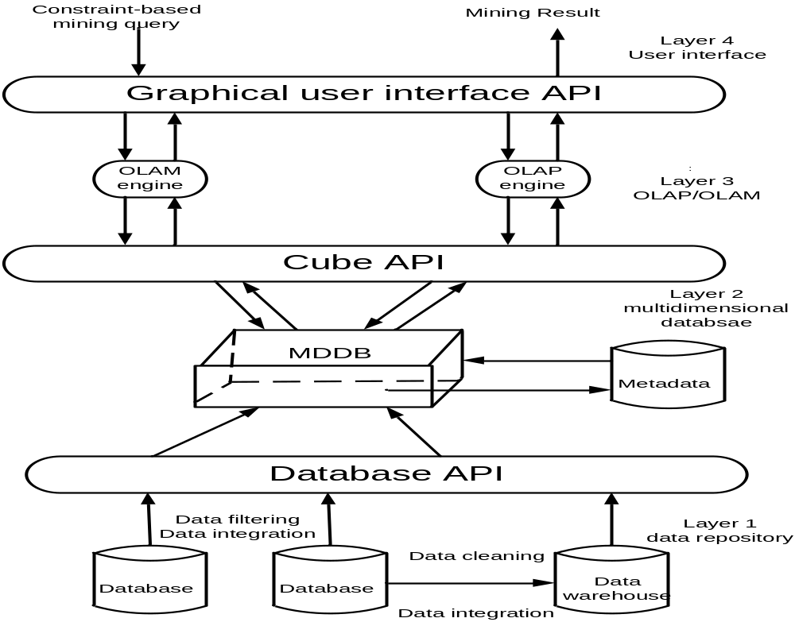
An integrated OLAM and OLAP architecture

Slide 26
Comparison between OLAP and OLAM
An OLAM server performs analytical mining in data cubes in a similar manner as an OLAP server.
An OLAM server may perform multiple data mining tasks, and is more sophisticated than an OLAP server.

Slide 27
Example: DBMiner
A DBMiner system is its tight integration of OLAP with a wide spectrum of data mining functions, which leads to OLAM, where the system provides a multidimensional view of its data and creates an interactive data mining environment: users can dynamically select data mining and OLAP functions, perform OLAP functions on data mining results.

Slide 28
Online analytical mining web-pages tick sequences
This case study applies an OLAM to facilitate the view maintainability in data warehouse, achieved by synchronizing the source databases update with the data warehousing update on web pages association rules tick sequences by the data operation function in the frame metadata model. Whenever an update occurs in the existing base relations, a corresponding update will be invoked by an event attribute in the constraint class in the model which will compute the association rules continuously.

Slide 29
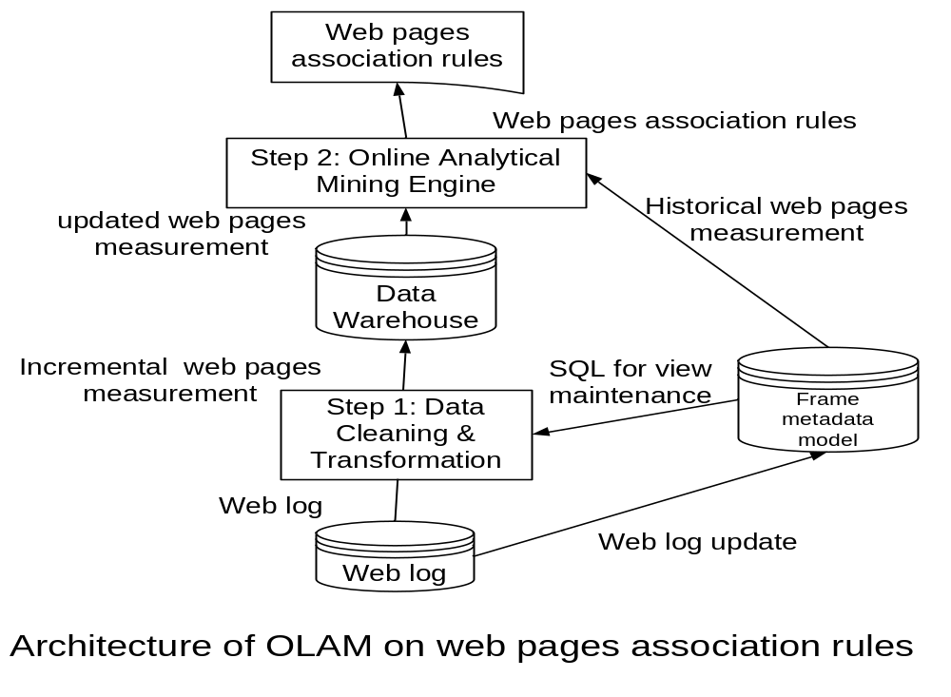

Slide 30
Source web log file (text file)
144.214.62.76 - - [07/MV/2000:19:33:23 +0800] "GET /~wjia HTTP/1.0" 301 312
144.214.121.103 - - [20/MV/2000:16:10:05 +0800] "GET /u_course.gif HTTP/1.0" 304 –

Slide 31
Main table
IP | Date | Time | Request | Files Request | Result | Size Received
144.214.62.76 | 07/Mar/2000 | 19:33:23 | GET | Page T-1 | 301 | 312
144.214.121.103 | 08/Mar/2000 | 16:10:05 | GET | Page T | 304 | -
Flattening table
IP Address | Page T-1 | Page T
144.214.62.76 | 1
144.214.121.103 |  | 2

Slide 32
Algorithm for recording web page tick sequences into data warehouse
Begin
For record added in log
Extract desired data fields and map into main table;
Flattening that record in flattening table;
Update relevant parameter attribute + 1;
Update target attribute with its associated parameter attribute + 1;
End For
If δR comes from updates to fact table destination relation
Then begin
Let δR’ = ∏A.δR, B.V (δR V1…… Vn)/* δR’ are tuples whose
values of grouping
attributes are not in the view */
If δR’ are tuples to be inserted /* tuples to be added into view */
Then V’ = V ∪ δR’; /* V’ = V + Applied Group by on δR’ with Aggregate
count by recomputing total count and aggregate count */
End

Slide 33
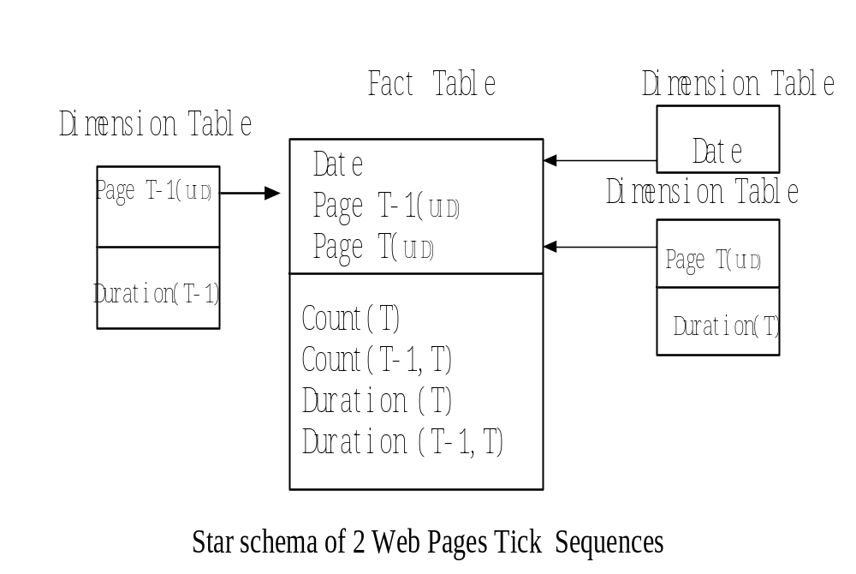

Slide 34
Dimension table source relation R_{SE}
Page T_{(UID)} | Duration
uid | t1
Dimension table source relation R_{SD}
Page T-1_{(UID)} | Duration
uid | t2
Dimension table source relation R_{SC}
Date
Date1

Slide 35
Fact table destination relation R_{D}
Date | Page T-1_{(UID)} | Page T_{(UID)} | Count(T) | Count(T,T-1) | Duration(T) | Duration(T-1,T)
... | ... | ... | ... |  |  | ...
Data warehouse view relation V (as a result of R_{S} R_{D})
Date | Page T-1_{(UID)} | Page T_{(UID)} | Count(T) | Count(T,T-1) | Duration(T) | Duration(T-1,T)
date1 | uid | uid | c1+c2 | c2 | t1 | t2

Slide 36
To be updated dimension table tuple δR (data to be updated to V)
Dimension table source relation R_{SE’}
Page T_{(UID)} | Duration
uid | t3
Dimension table source relation R_{SD’}
Page T-1_{(UID)} | Duration
uid | t4
Dimension table source relation R_{SC’}
Date
Date2

Slide 37
To be updated fact table update δR’ (data to be updated to V)
Date | Page T-1_{UID} | Page T_{UID} | Count(T) | Count(T,T-1) | Duration(T) | Duration(T-1,T)
Date2 | uid | uid | c3+c4 | c4 | t3 | t4
Updated view relation V’ (V after updated)
Date | Page T-1_{UID} | Page T_{UID} | Count(T) | Count(T,T-1) | Duration(T) | Duration(T-1,T)
date2 | uid | uid | c1+c2+c3+c4 | c2+c4 | t1+t3 | t2+t4

Slide 38
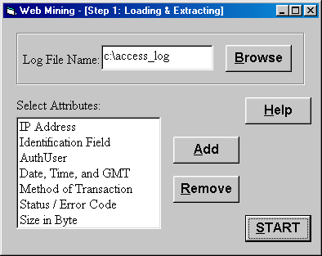

Slide 39
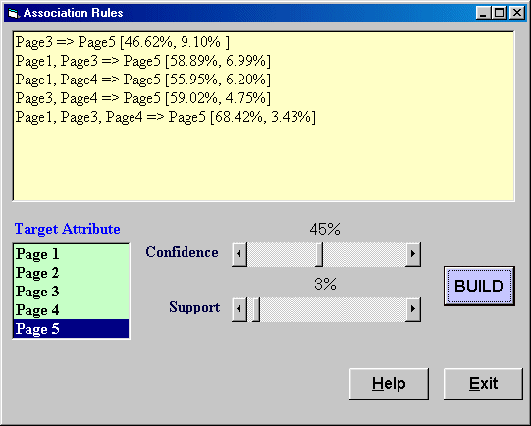

Slide 40
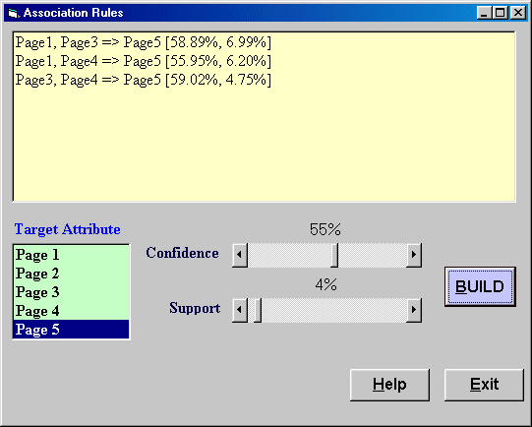

Slide 41
Reading Assignment
“Data Mining: Concepts and Techniques” 2nd edition by Han and Kamber, Morgan Kaufmann publishers, 2007, Chapter 10, pp. 628-641.
Chapter 8 of “Information Systems Reengineering and Integration” by Joseph Fong, published by Springer Verlag, 2006,, pp. 311-345.

Slide 42
Lecture Review Question 8
Define Forward maximal sequence, its algorithm and what is its application on customer relationship management in e-commerce.

Slide 43
Tutorial Question 8
Find the maximal forward references of web pages in a database D of sessions (A, B, C), (A, C, B), (B, C, E), (A, C), (A, C, D, C, E) and (A, B, C, A, C, B, C, A, C, D, E) with the minimum support Smin of two sessions.

